Slide 1
Single Cycle Processor Design using Verilog

Slide 2
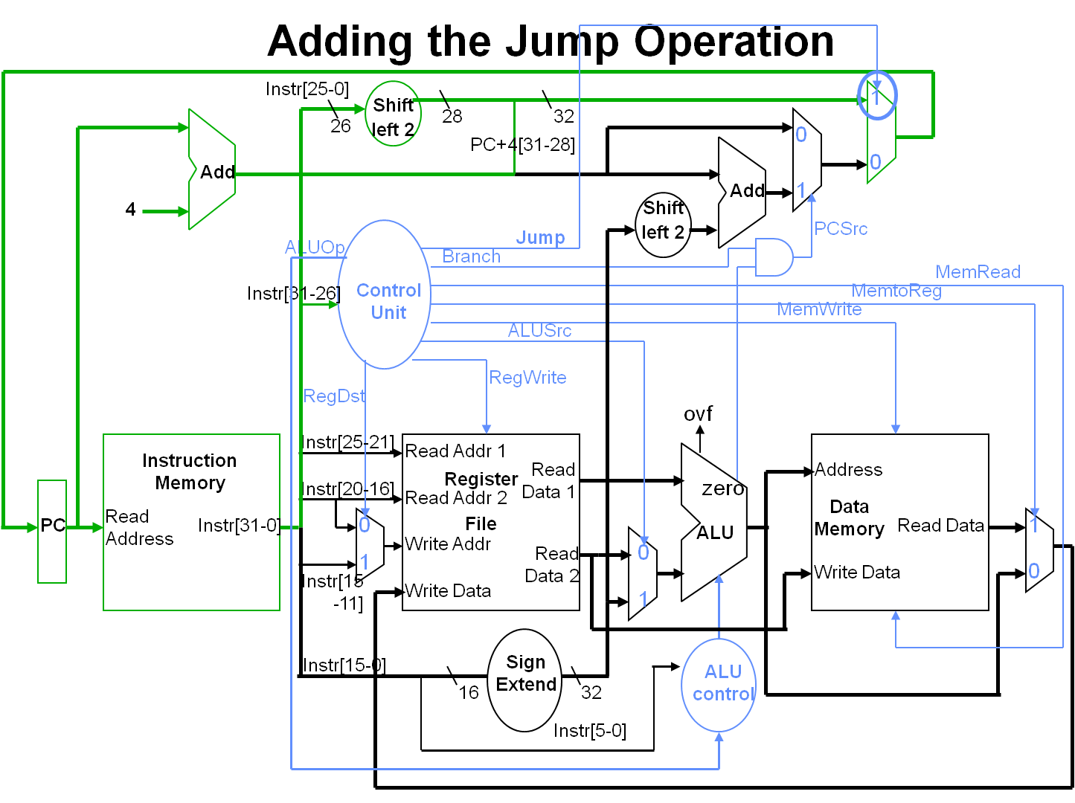

Slide 3
module processor(Clock, Reset);
input Clock, Reset;
wire [31:0] PC_out, PC_In; //from pc
wire [31:0] Instruction; //from instruction memory
wire [31:0] IncPC; //from adder incrementing pc
// from control unit
wire RegDst, RegWrite, ALUSrc, MemRead, MemWrite, MemToReg, Branch, Jump;
wire [1:0] ALUOp; //from control
wire [4:0] WriteAddr, JumpAddr; //from mux_reg
wire [31:0] ReadData1, ReadData2; //from register
wire [31:0] Out_signExtend; //from sign extension
wire [31:0] In_B, In_shift, ShiftWire; //from alu muxs
wire [3:0] In_Control; //from ALU control
wire ShiftFunc, JR;
wire [31:0] ALU_out; //from alu
wire Zero, BranchType; //from alu
wire [31:0] MemData; //from memory access
wire [31:0] WriteData, JumpData; //from memory access mux
wire [31:0] BranchAddress; //from branch adder
wire [31:0] PC_Jump, JumpAddress, JumpAddress2; //from jump mux

Slide 4
PC PC_module(PC_out, PC_In, Clock, Reset);
instructionMemory ins(Instruction, PC_out);
adder_32bit increment_PC(IncPC, , , PC_out, 32'd4, 1'b0);
controlUnit MainControl(ALUOp, RegDst, RegWrite, ALUSrc, MemRead, MemWrite, MemToReg, Branch, Jump, Instruction[31:26]);
mux_2_1_5b mux_reg(JumpAddr, Instruction[20:16],
Instruction[15:11], RegDst);

Slide 5
module PC(Out, In, Clock, Reset);
output[31:0] Out;
input [31:0] In;
input Clock, Reset;
reg [31:0] Out;
initial begin
Out = 32'd0;
end
always@(posedge Clock or posedge Reset) begin
if(Reset == 1'b1)
Out <= 32'd0;
else
Out <= In;
end
endmodule

Slide 6
module instructionMemory(ReadData, Address);
output[31:0] ReadData;
input [31:0] Address;
reg [7:0] memory[512:0]; //512 locations of byte size memory
reg [31:0] ReadData;
//initialize memory (program in a sense)
initial begin
memory[0] <= 8'b00100100; //addiu $1, $0, 10
memory[1] <= 8'b00000001;
memory[2] <= 8'b00000000;
memory[3] <= 8'b00001010;
memory[4] <= 8'b00100100; //addiu $1, $0, 15
memory[5] <= 8'b00000010;
memory[6] <= 8'b00000000;
memory[7] <= 8'b00001111;
memory[8] <= 8'b00000000; //subu $3, $2, $1
memory[9] <= 8'b01000001;
memory[10] <= 8'b00011000;
memory[11] <= 8'b00100011;

Slide 7
.. …. .. . ……………// all instructions need to be examined
memory[500] <= 8'b00000011; //jr $31
memory[501] <= 8'b11100000;
memory[502] <= 8'b11111000;
memory[503] <= 8'b00001000;
ReadData <= {memory[0], memory[1], memory[2], memory[3]};
end
//read and write memory
always @ (Address) begin
ReadData = {memory[Address], memory[Address+1], memory[Address+2], memory[Address+3]};
end
endmodule

Slide 8
module adder_32bit (Sum, C_out, overflow, A, B, Mode);
output [31:0] Sum;
output C_out, overflow;
input [31:0] A, B;
input Mode;
wire [31:0] Sum;
wire C_out;

Slide 9
module controlUnit (ALUOp, RegDst, RegWrite, ALUSrc, MemRead, MemWrite, MemToReg, Branch, Jump, Instruction);
input [5:0] Instruction;
output [1:0] ALUOp;
output RegDst, RegWrite, ALUSrc, MemRead, MemWrite, MemToReg, Branch, Jump;
reg [1:0] ALUOp;
reg RegDst, RegWrite, ALUSrc, MemRead, MemWrite, MemToReg, Branch, Jump;
always@(Instruction) begin
case(Instruction)
6'd0: begin //addu, subu, mult, div, and, or, xor, sll, sra, srl, slt, sltu, jr
RegDst <= 1'b1;
RegWrite <= 1'b1;
ALUSrc <= 1'b0;
MemRead <= 1'b0;
MemWrite <= 1'b0;
MemToReg <= 1'b0;
Branch <= 1'b0;
Jump <= 1'b0;
ALUOp <= 2'b10;
end

Slide 10
module mux_2_1_5b (Out, In0, In1, sel);
output [4:0] Out;
input [4:0] In0, In1;
input sel;
wire [4:0] Out;
assign Out[0] = ~sel&In0[0] | sel&In1[0];
assign Out[1] = ~sel&In0[1] | sel&In1[1];
assign Out[2] = ~sel&In0[2] | sel&In1[2];
assign Out[3] = ~sel&In0[3] | sel&In1[3];
assign Out[4] = ~sel&In0[4] | sel&In1[4];
endmodule

